Slide 1


mofover
12 May 2025

Slide 2

Outline
Executive Summary
Introduction
Methodology
Results
Conclusion
Appendix

Slide 3
Executive Summary
Summary of methodologies
Data collection:
API
Web Scraping
Data wrangling
EDA with SQL
Data Visualization with Dash, Ploty, and Folium
Predications with supervised machine learning
Summary of all results
Interactive & predictive analytics

Slide 4
Introduction
Project background and context
SpaceX advertises Falcon 9 rocket launches on its website for $62 million, while other providers charge upwards of $165 million per launch. Much of SpaceX’s cost savings come from its ability to reuse the rocket’s first stage.
Therefore, by predicting whether the first stage will successfully land, we can estimate the cost of a launch. This information would be valuable for an alternative company looking to compete with SpaceX on launch bids.
The goal of this project is to develop a machine learning pipeline to predict the whether SpaceX will can land a rocket successfully.
Problems you want to find answers
What are the factors that could influence a successful landing?
What interactions between various features could influence a successful landing?

Slide 5

Section 1

Slide 6
Methodology
Executive Summary
Data collection methodology:
Space X website
Web scraping from Wikipedia
Perform data wrangling
EDA to find patters in the data in order to determine what would be the label for training a supervised machine learning model
Perform exploratory data analysis (EDA) using visualization and SQL
Perform interactive visual analytics using Folium and Plotly Dash
Perform predictive analysis using classification models
How to build, tune, evaluate classification models

Slide 7
Data Collection
Describe how data sets were collected.
Data was collected through two sources: SpaceX API & Wikipedia
The SpaceX API provided data about launches that included data points such as the type of rocket used, payload, and landing outcomes
Data was in the form of JSON and converted to a dataframe
Data on Falcon 9 launches was scraped from Wikipedia with the use of BeautifulSoup

Slide 8
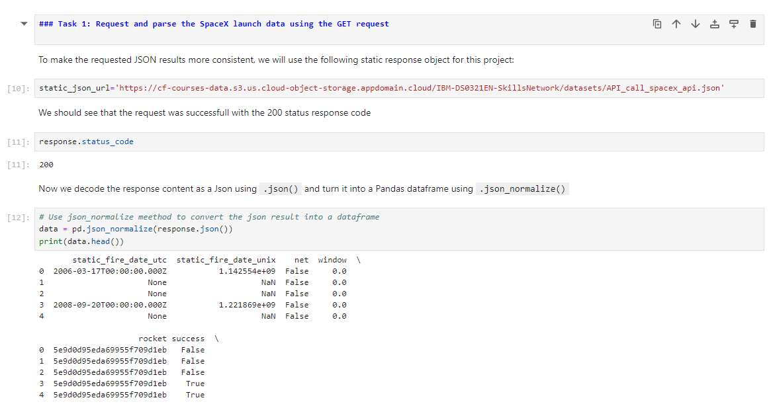
Data Collection – SpaceX API
Through the SpaceX API data was collected and retrieved as a JSON object, which was converted into a dataframe
Applied-Data-Science-Capstone/jupyter-labs-spacex-data-collection-api-v2_final.ipynb at main · mofover/Applied-Data-Science-Capstone

Slide 9
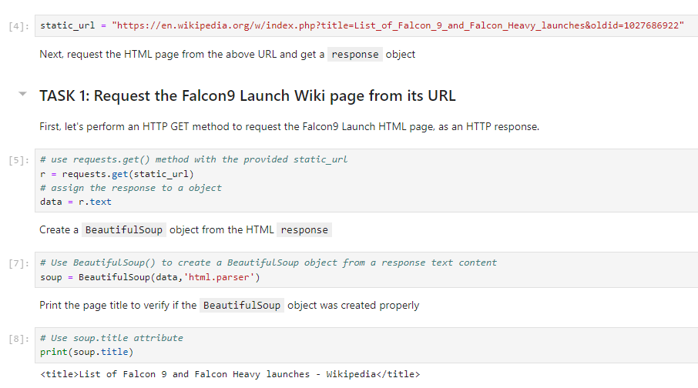
Data Collection - Scraping
From Wikipedia data on Falcon 9 was scrapped using BeautifulSoup
This data was converted into a dataframe with Pandas
Applied-Data-Science-Capstone/jupyter-labs-spacex-data-collection-api-v2_final.ipynb at main · mofover/Applied-Data-Science-Capstone

Slide 10
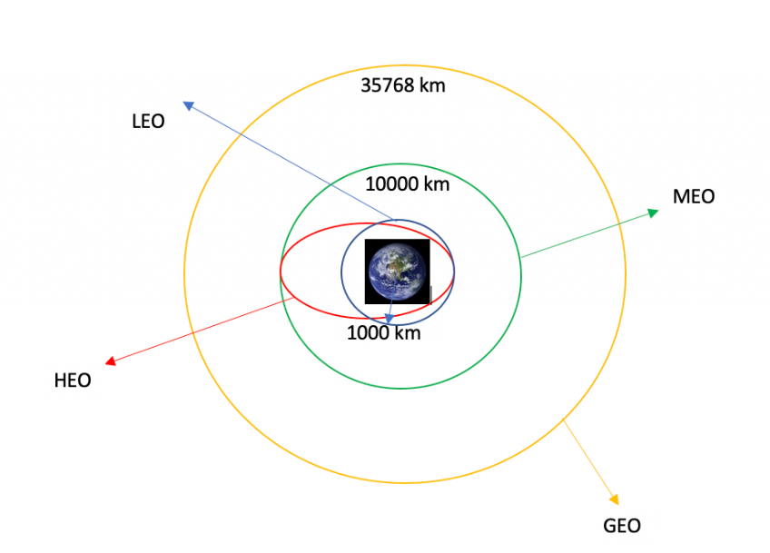
Data Wrangling
The data was processed with EDA methods such as counting launches at each site, the number of each orbits, as well as the number and occurrence of mission outcomes of the orbits.
Applied-Data-Science-Capstone/labs-jupyter-spacex-Data wrangling-v2_final.ipynb at main · mofover/Applied-Data-Science-Capstone

Slide 11
EDA with Data Visualization
Chart summary:
Relationship between flight number and launch site
Relationship between payload and launch site
Relationship between success rate of each orbit type
Relationship between flight number and orbit type
Relationship between payload and orbit type
Launch success yearly trend
Applied-Data-Science-Capstone/jupyter-labs-eda-sql-coursera_sqllite_final.ipynb at main · mofover/Applied-Data-Science-Capstone

Slide 12
EDA with SQL
The following SQL queries were performed to return
a distinct list of launch sites including ones that include “CCA”
aggregated and average payload mass by different boosters
a list of boosters that had carried the highest mass as well as mass between 4K and 6K
a list of successful and failed mission outcomes
the date of first successful landing
the count of as well as the records of failed outcomes in 2015
A ranking of landing outcomes between the dates Jun 4, 2010 and Mar 20, 2017
Applied-Data-Science-Capstone/jupyter-labs-eda-sql-coursera_sqllite_final.ipynb at main · mofover/Applied-Data-Science-Capstone

Slide 13
Build an Interactive Map with Folium
Summarize what map objects such as markers, circles, lines, etc. you created and added to a folium map
Explain why you added those objects
Applied-Data-Science-Capstone/lab-jupyter-launch-site-location-v2_final.ipynb at main · mofover/Applied-Data-Science-Capstone

Slide 14
Build a Dashboard with Plotly Dash
With Ploty & Dash, a pie chart that illustrates total successful launches at each site
Scatter plot that demonstrates success rates of different payload weights (Low vs heavy)
Applied-Data-Science-Capstone/Interactive - app_final.py.ipynb at main · mofover/Applied-Data-Science-Capstone

Slide 15
Predictive Analysis (Classification)
With Ploty & Dash a pie chart and a scatter plot graph was created.
The pie chart shows the percentage of launch success at each site.
The scatter plot graphs shows how the outcome is impacted by the payload mass
Applied-Data-Science-Capstone/SpaceX-Machine-Learning-Prediction-Part-5-v1_final.ipynb at main · mofover/Applied-Data-Science-Capstone

Slide 16
Results
Exploratory data analysis results
Interactive analytics demo in screenshots
Predictive analysis results

Slide 17

Section 2

Slide 18
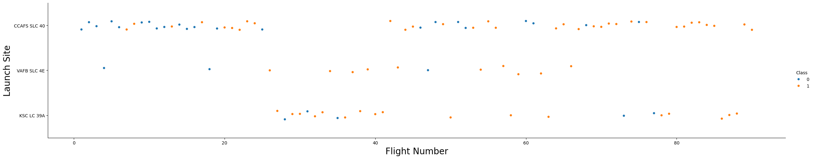
Flight Number vs. Launch Site
The scatter plot provides the flight number on the x-axis and the launch site on the y-axis and should help identify any relationship between successful launch by flight number. As the scatter plot shows that there is a higher chance of success if the flight number is higher particularly at launch site “CCAFS SLC 40”.

Slide 19
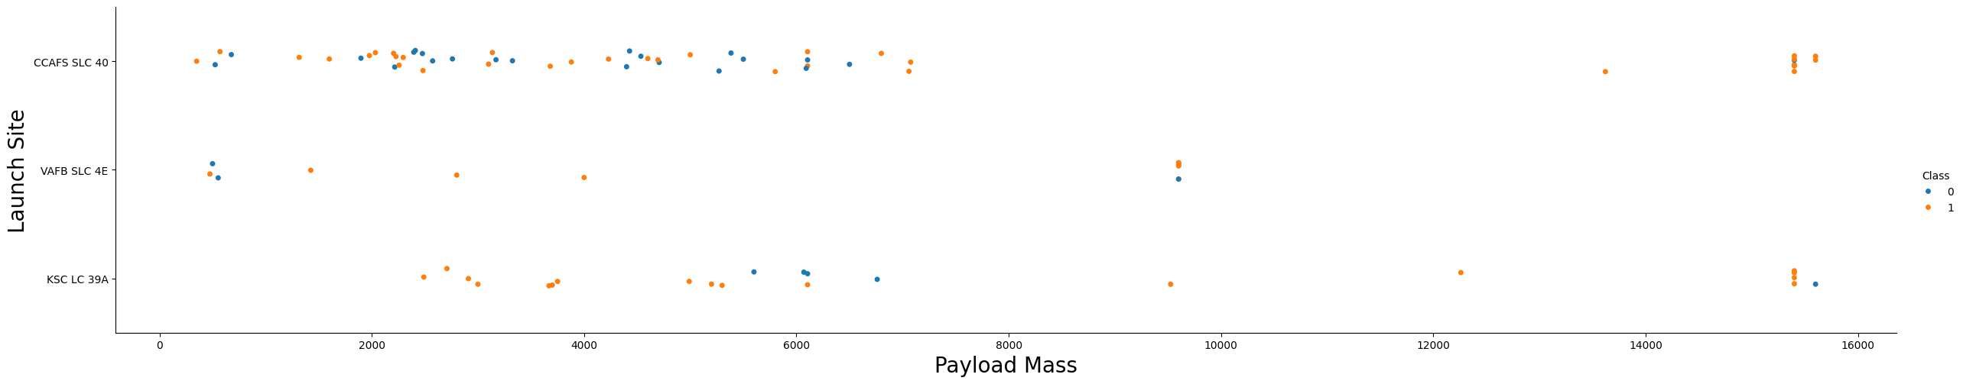
Payload vs. Launch Site
The scatter plot provides the payload mass on the x-axis and launch site on the y-axis. The scatter plot should help identify whether the higher the payload mass impacts the success of the launch. As it shows most (but not all) of the launches that had payloads greater than 1300 had a higher chance of success.

Slide 20
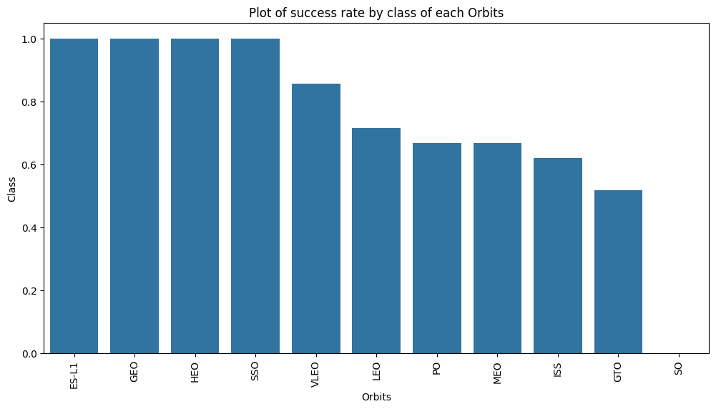
Success Rate vs. Orbit Type
The launch sites with the highest success rates were ES-L1, GEO, HEO, SSO and followed by VLEO and LEO.

Slide 21
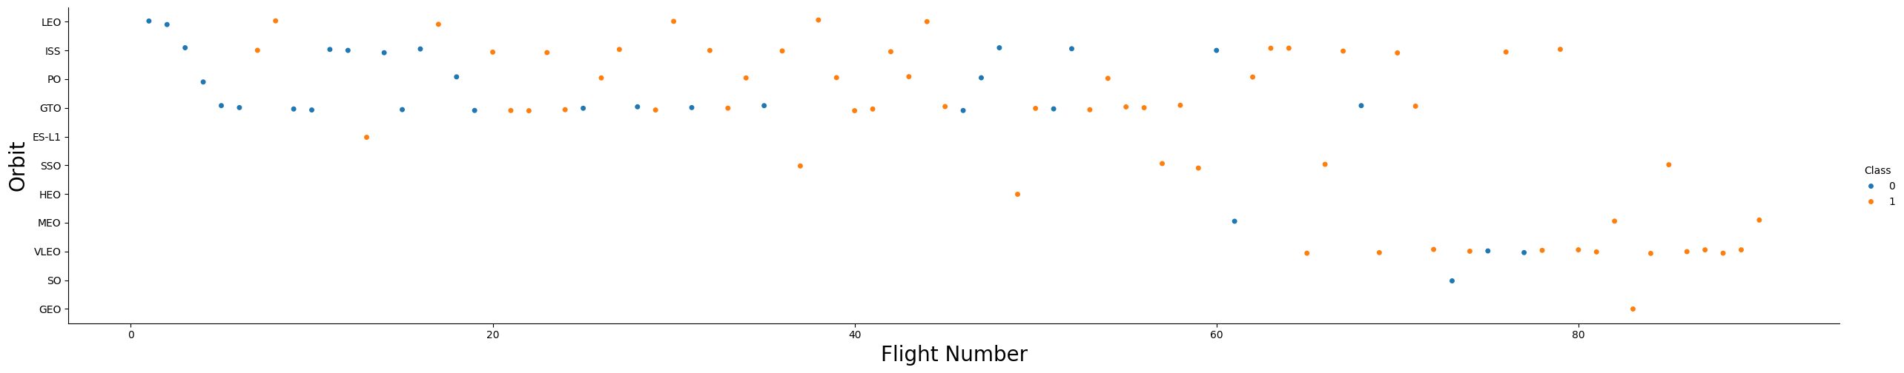
Flight Number vs. Orbit Type
The scatter plot provides the flight number on the x-axis and the orbit on the y-axis. The scatter plot should help identify any relationship between the success of the flight by orbit type; however, based on the graph, there doesn’t seem to be a relationship between these attributes.

Slide 22
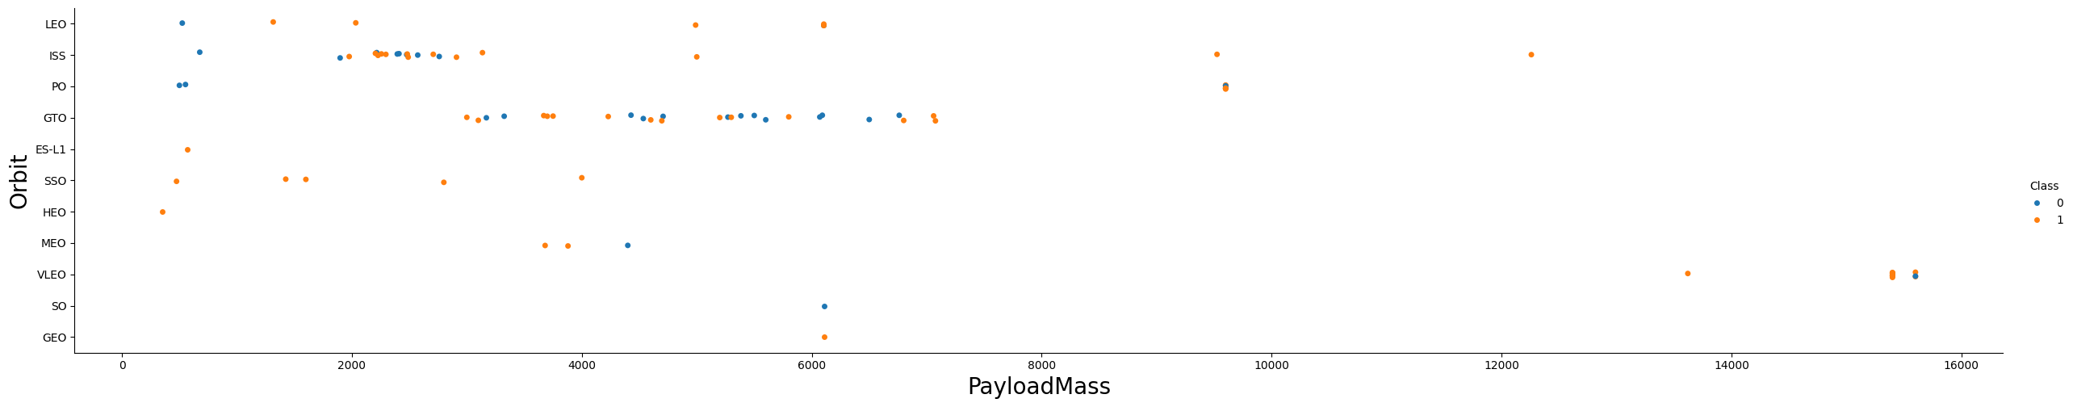
Payload vs. Orbit Type
The scatter plot provides the payload mass on the x-axis and orbit type on the y-axis. The scatter plot should help identify whether the higher the payload mass impacts the success of the launch based on orbit type. Based on the scatter plot, there doesn’t seem to be any relationship between payload mass and orbit type.

Slide 23
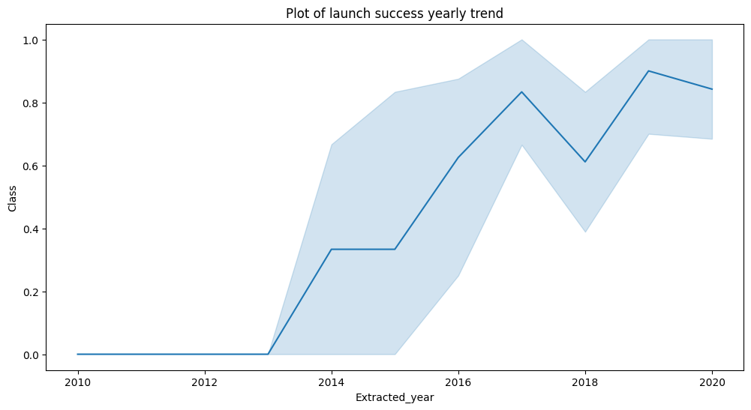
Launch Success Yearly Trend
The plot provides a timeline of launch success. On the x-axis is the year and the class on the y-axis. The timeline should help identify a favorable trend of successful launches by year.

Slide 24
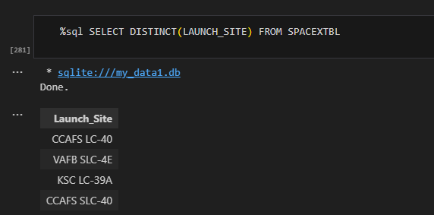
All Launch Site Names
The SQL query returned the following list of distinct launch sites:
CCAFS LC-40
VAFB SLC-4A
KSC LC-39A
CCAFS CLS-40

Slide 25
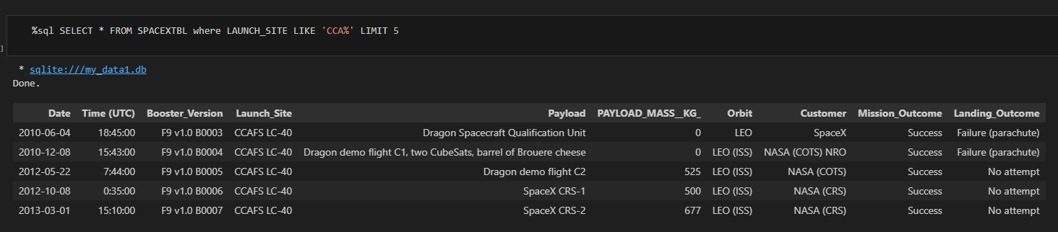
Launch Site Names Begin with 'CCA'
The SQL query returned a sample of records in which launch sites begin with “CCA”.

Slide 26
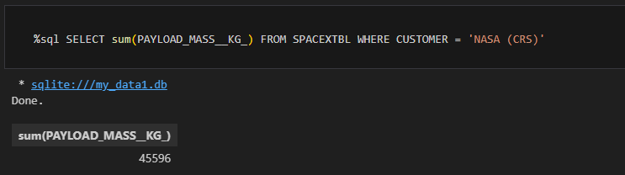
Total Payload Mass
The SQL query turned the sum of the total payload mass of 45,596 for customer NASA (CRS).

Slide 27
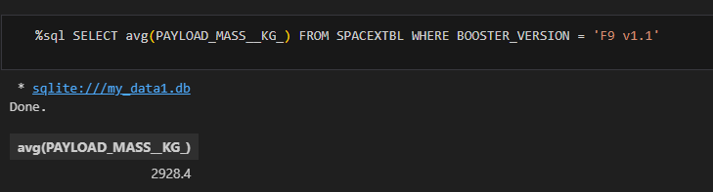
Average Payload Mass by F9 v1.1
The SQL query returned the average payload mass carried by booster version F9 v1.1 is 2,928.40.

Slide 28
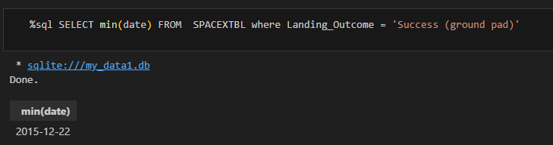
First Successful Ground Landing Date
The SQL query returned the date of the first successful landing outcome on ground pad, which was performed on December 22, 2015.

Slide 29
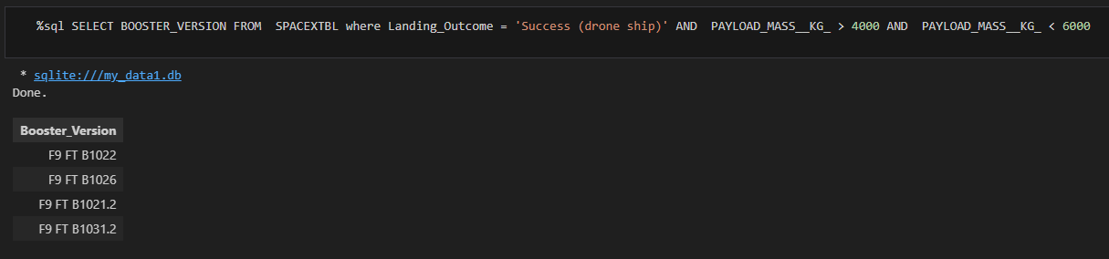
Successful Drone Ship Landing with Payload between 4000 and 6000
The SQL query returned a list of boosters that have successfully landed on drone ship and had payload mass greater than 4,000 but less than 6,000 are:
F9 FT B1022
F9 FT B1026
F9 FT B1021.2
F9 FT B1031.2

Slide 30
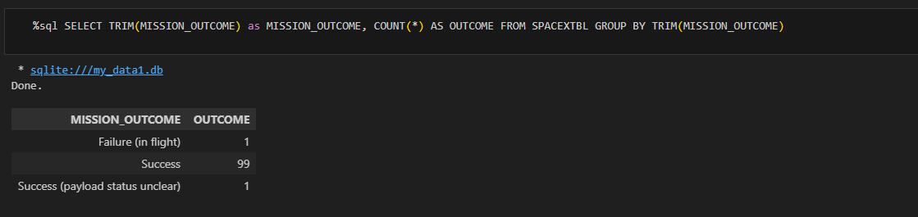
Total Number of Successful and Failure Mission Outcomes
The SQL query returned an aggregation of launch outcomes. Out of 101 launches, the total number of successful and failure mission outcomes are:
100 successful (1 success but payload status was not defined)
1 failure

Slide 31
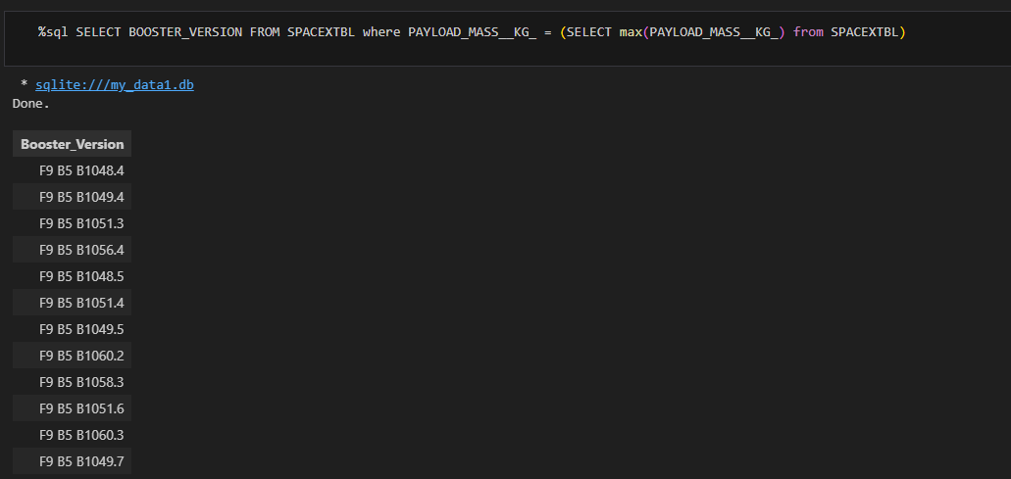
Boosters Carried Maximum Payload
The SQL query provides the list of boosters that have carried the highest payload masses.

Slide 32
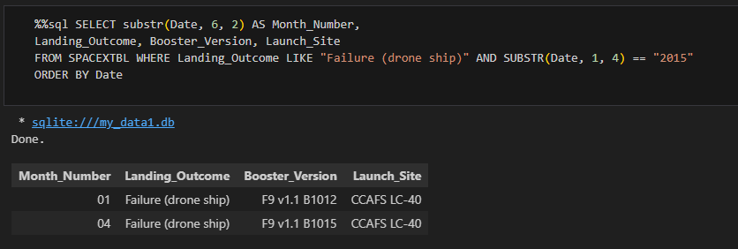
2015 Launch Records
List the failed landing_outcomes in drone ship, their booster versions, and launch site names for in year 2015

Slide 33
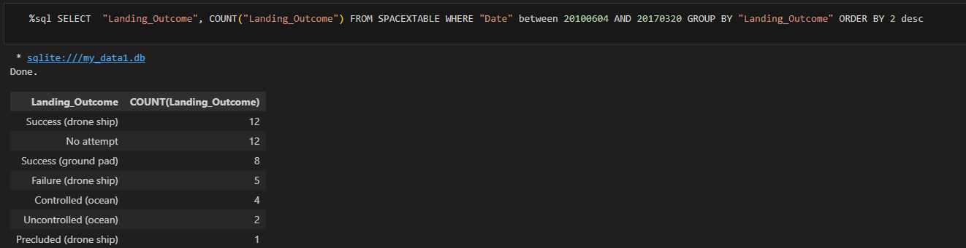
Rank Landing Outcomes Between 2010-06-04 and 2017-03-20
The SQL query ranks by descending count the landing outcomes from June 6, 2010 until March 20, 2017. The “Success (drone ship)” tied with “No attempt” have the most landing outcomes.

Slide 34

Section 3

Slide 35
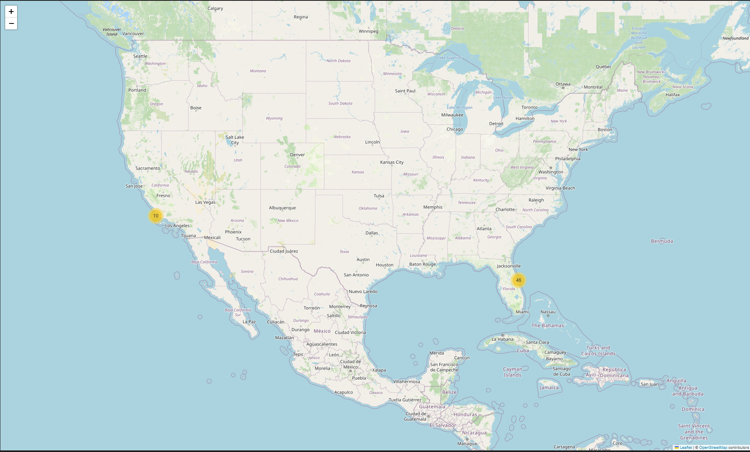
<Folium Map Screenshot 1>
The launch sites are in California and Florida, in which Florida has more than California.

Slide 36
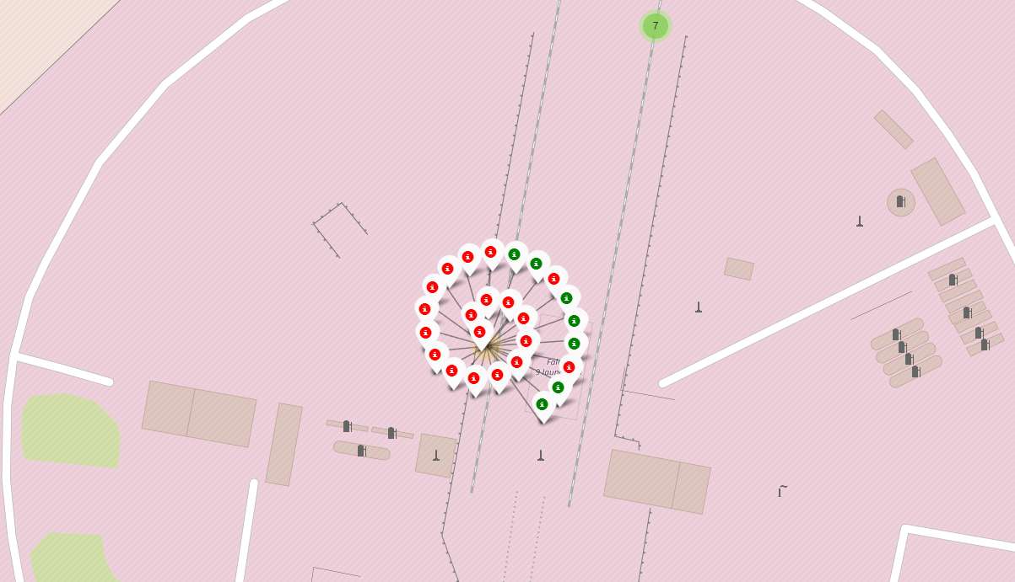
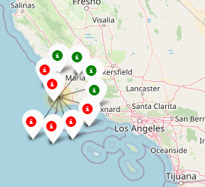
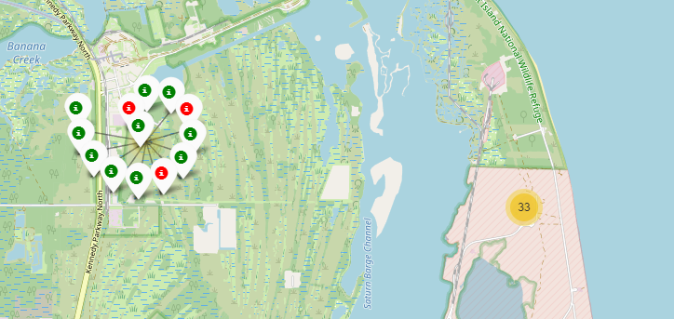
Florida & California Launch Sites Outcomes
Florida Launches
California Launches
1
Green markers show successful launches
Red markers indicate failed launches
Florida has preformed more launches than California.
The second Florida site has performed more successful launches than failed launches
2

Slide 37
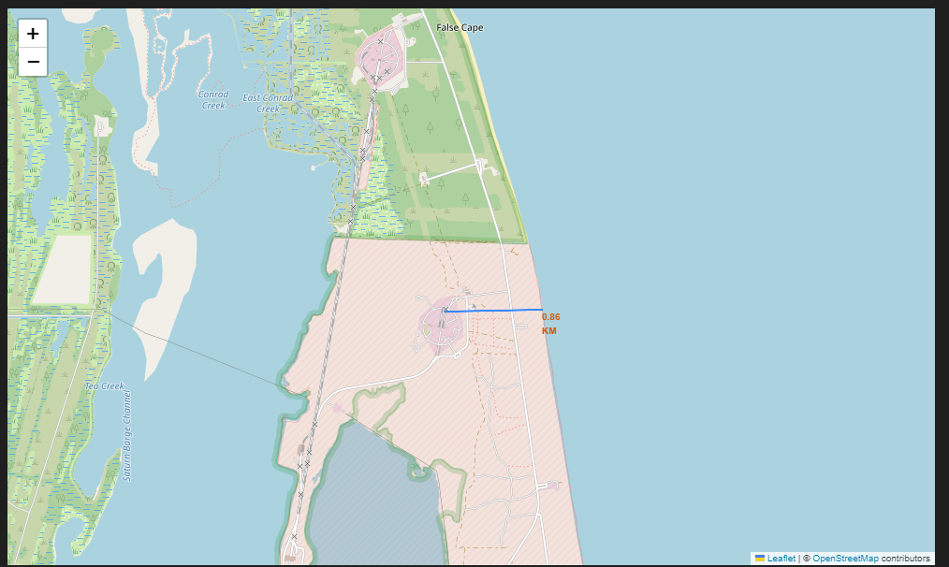
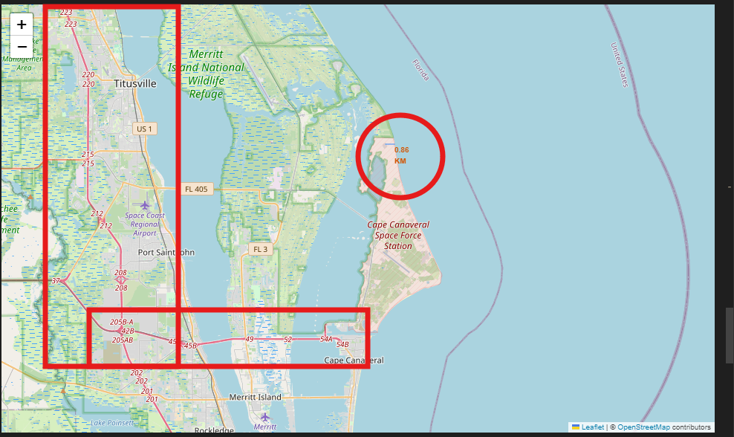
Coastline Proximity
The selected launch site in Florida is in close proximity to coastline but not to any freeway or highway systems.

Slide 38

Section 4

Slide 39
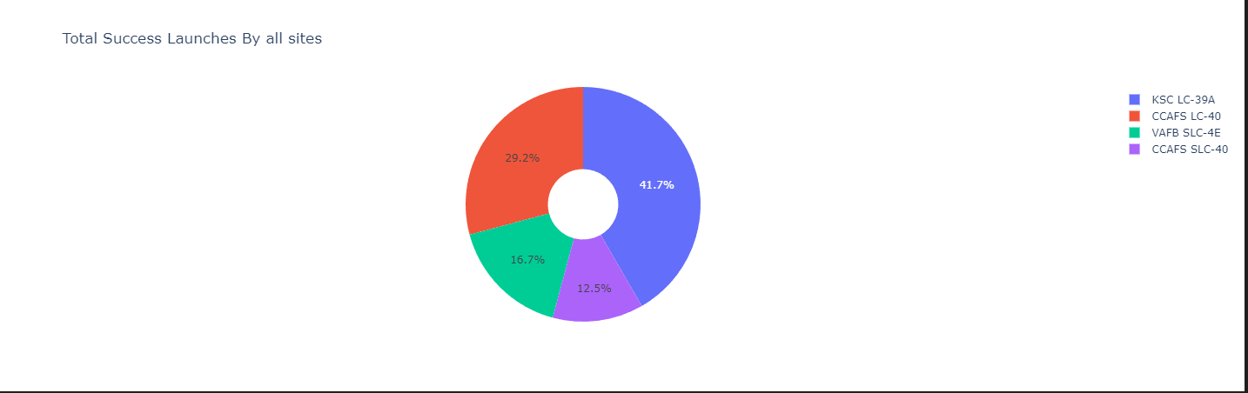
Total Success Launches by Site
Out of the total launches of all sites, KSC LC-39A had the most successful launches; whereas CCAFS SCL-40 had the least successful launches.

Slide 40
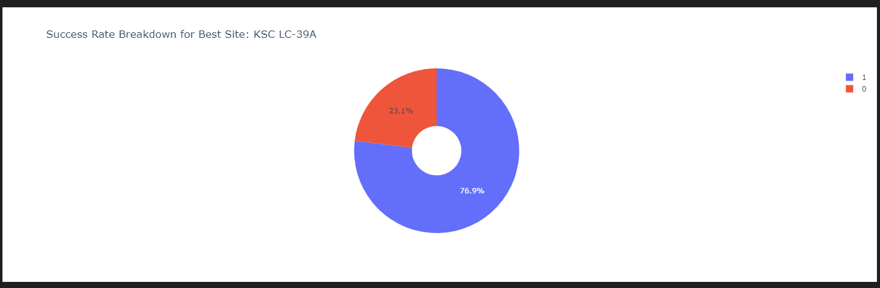
Success Rate Breakdown for Best Site
Site KSC LC-39A had the most successful rate of launches in which 76.9% where successful.

Slide 41
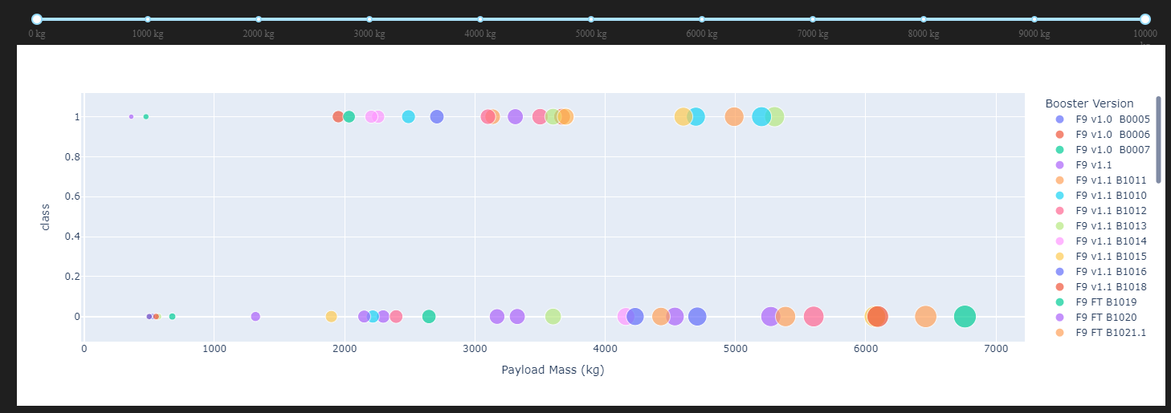
<Dashboard Screenshot 3>
Replace <Dashboard screenshot 3> title with an appropriate title
Show screenshots of Payload vs. Launch Outcome scatter plot for all sites, with different payload selected in the range slider
Explain the important elements and findings on the screenshot, such as which payload range or booster version have the largest success rate, etc.

Slide 42

Section 5

Slide 43
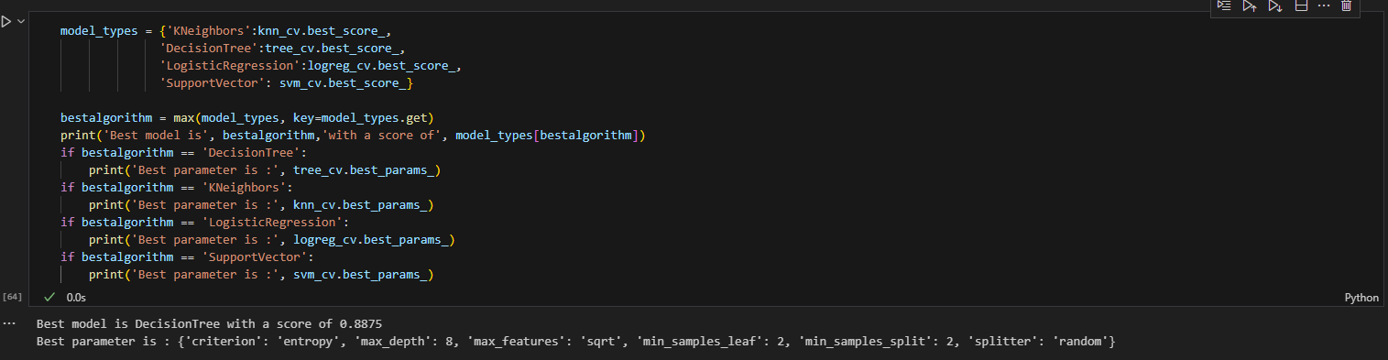
Classification Accuracy
The model that has the highest classification accuracy is DecisionTree with a score of 0.8875.

Slide 44
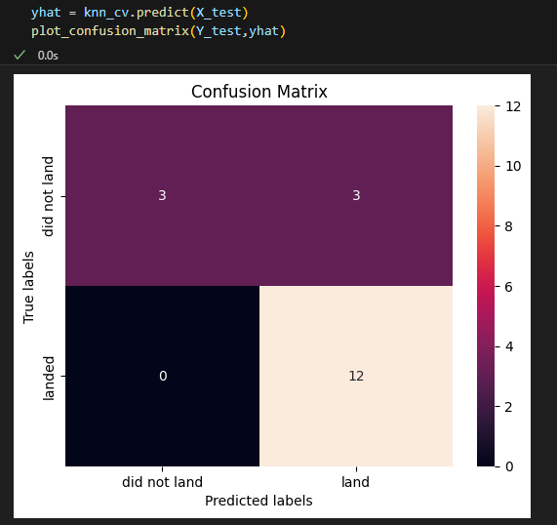
Confusion Matrix
The confusion matrix shows the prediction versus the outcome of 18 test cases.
It correctly predicted 12 successful landings and 3 failed landings.
It did not result in any false negatives but it did calculate 3 false negatives.

Slide 45
Conclusions
The results showed that the more launches a site had, the higher the success rate of future launches.
The success rates of the launches improved on average over the timeframe of the data
KSC LC-39A had the most successful launches compared to the other sites.
The best performing predictive model was the DescisionTree

Slide 46
Appendix
Include any relevant assets like Python code snippets, SQL queries, charts, Notebook outputs, or data sets that you may have created during this project

Slide 47


